Slide 1
Defending the Fortress – The Human Factor

Slide 2
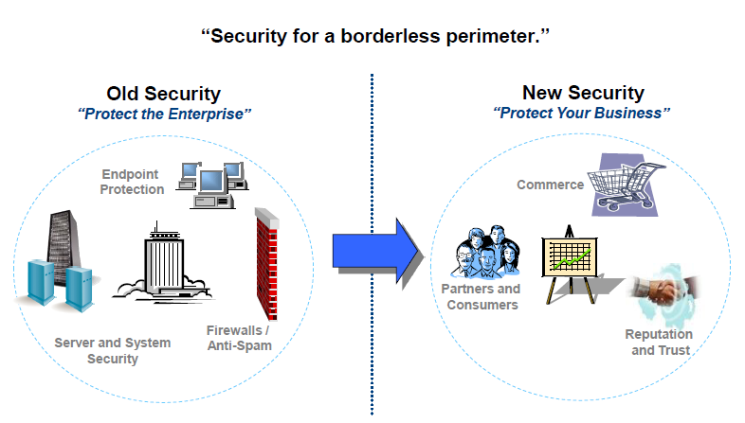
The New Model for Security

Slide 3
What is Social Engineering
Definition: The process of deceiving people into giving away access or confidential information.
In other Words – Hacking People !

Slide 4
History
Social Engineering is one of the oldest hacking Techniques around
Perfected by John Draper (Cap’n Crunch) in the days of Phreaking (Phone Hacking and used by Kevin Mitnik to gain access to many computer systems/
However, evidence of Social Engineering can even be found in the bible (Genesis 27).

Slide 5
Before the Attack
Reconnaissance (RECON), also known as scouting, is the military term for exploring beyond the area occupied by friendly forces to gain information about enemy forces or features of the environment.

Slide 6
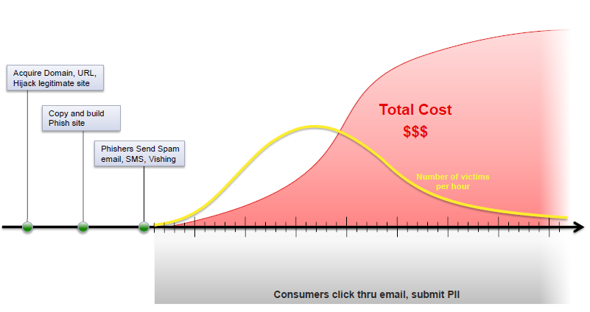
Anatomy of a Phish

Slide 7
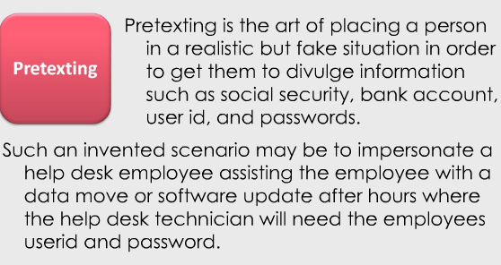
Pretexing

Slide 8
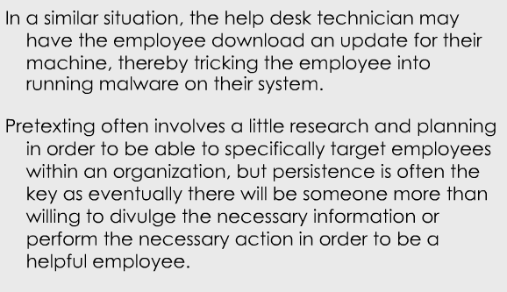
Pretexing

Slide 9
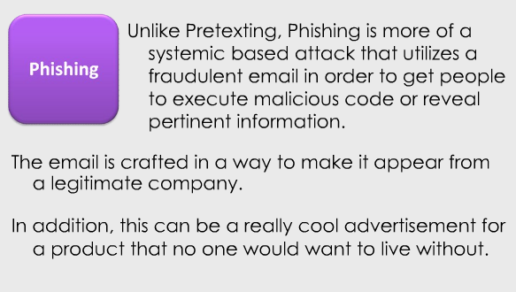
Phishing

Slide 10
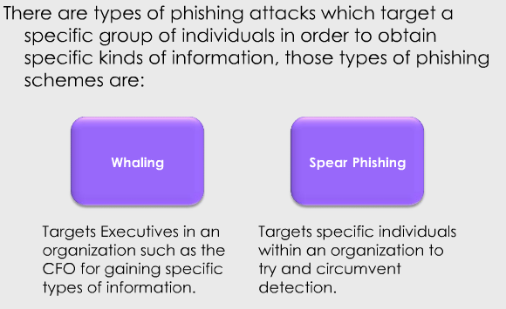
Phishing Attack Categories

Slide 11
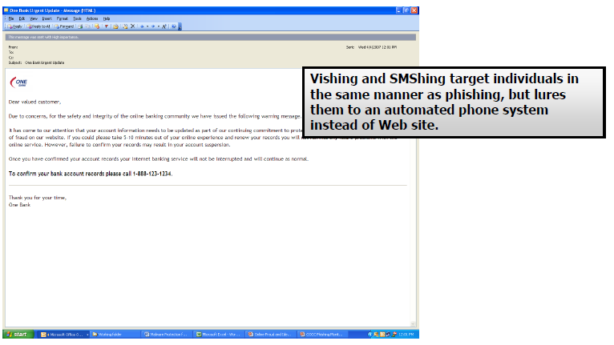
Vishing and SMShing

Slide 12
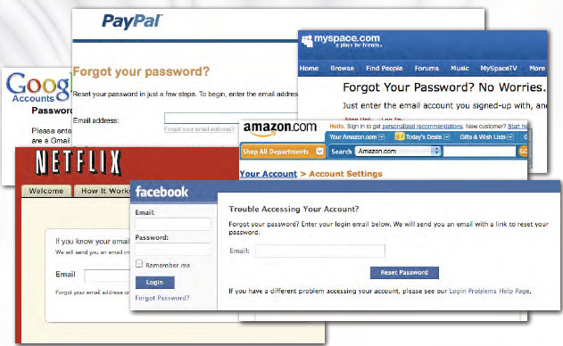
Email Preferred Over Secret Questions

Slide 13
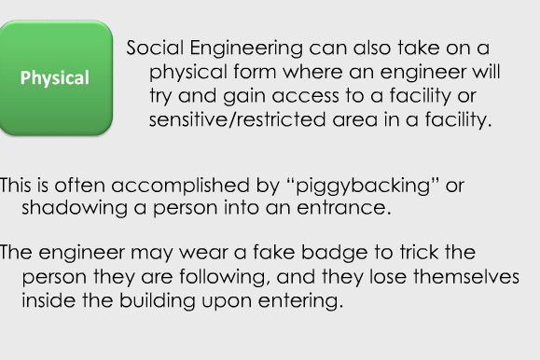
Physical

Slide 14
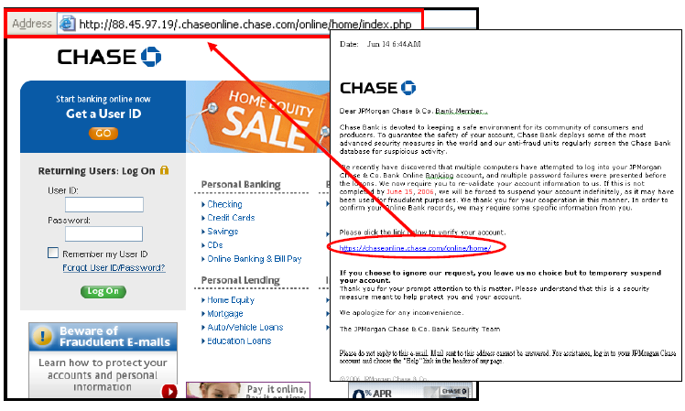
Phishing Attack

Slide 15
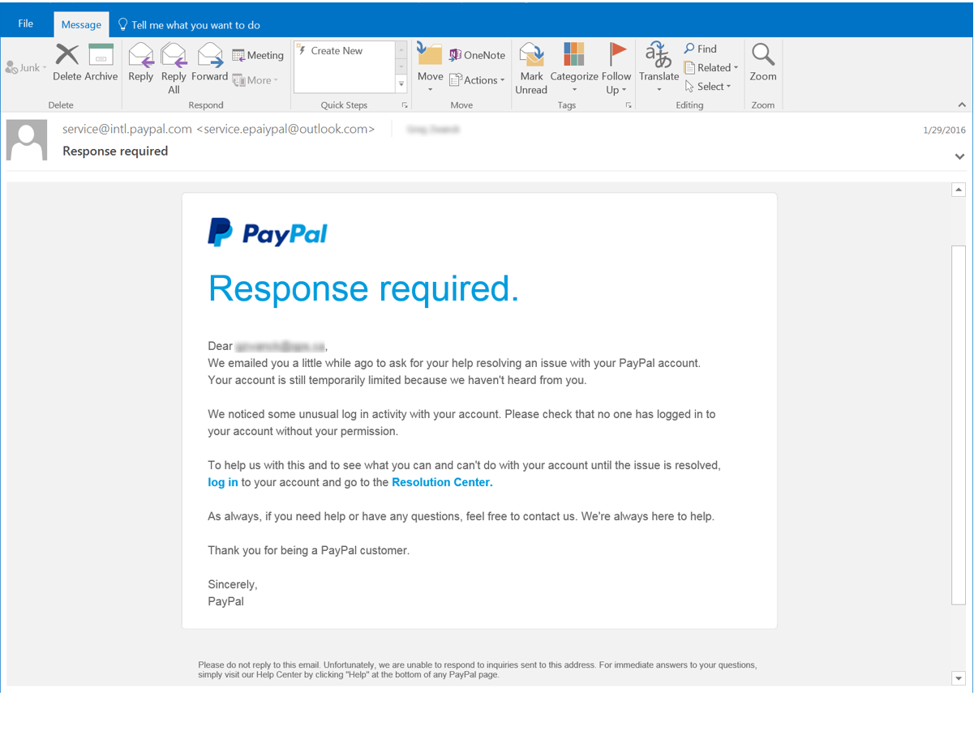
PHISHING EMAIL

Slide 16
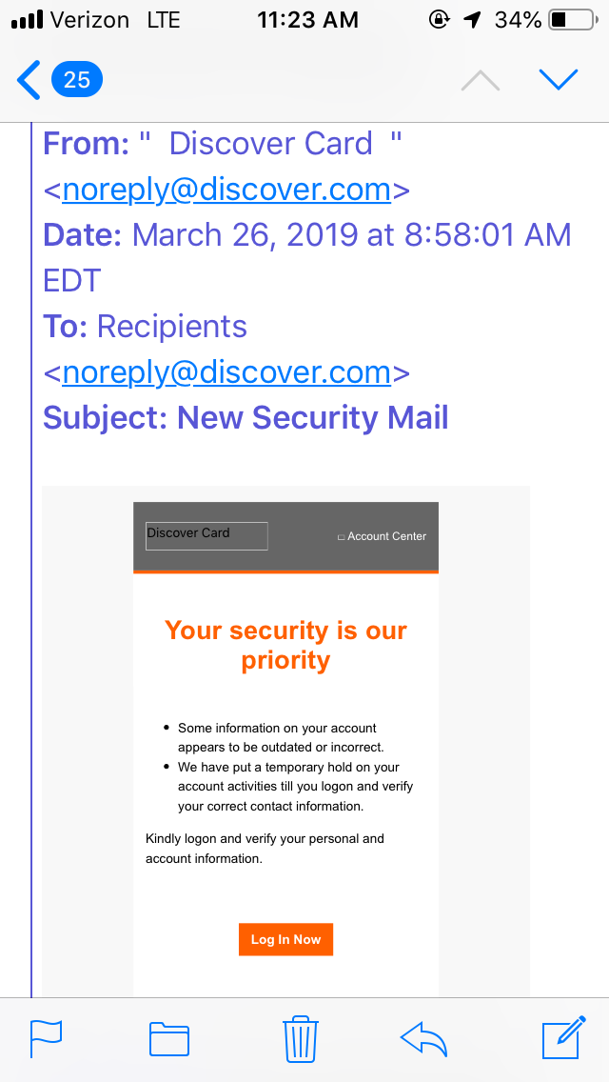
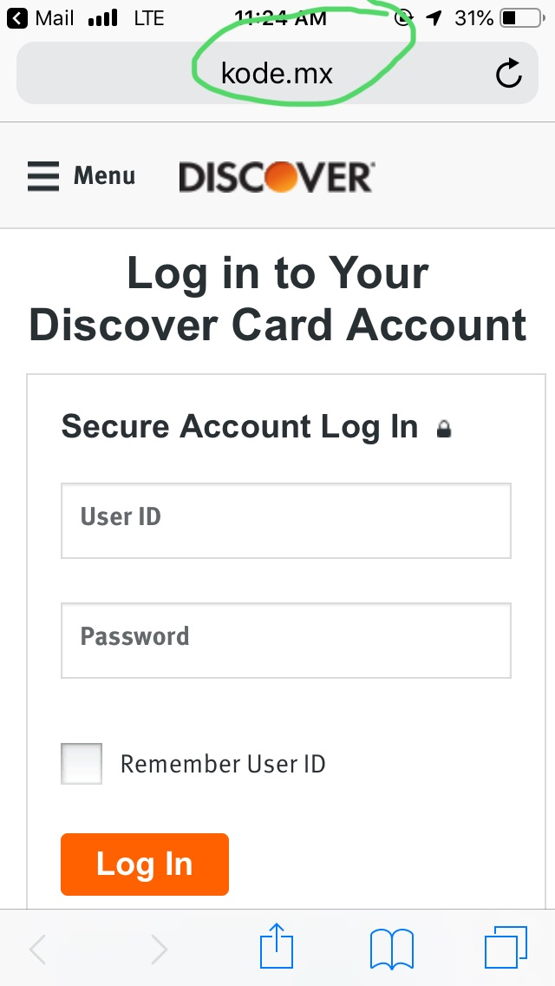
Phishing Email - Iphone

Slide 17
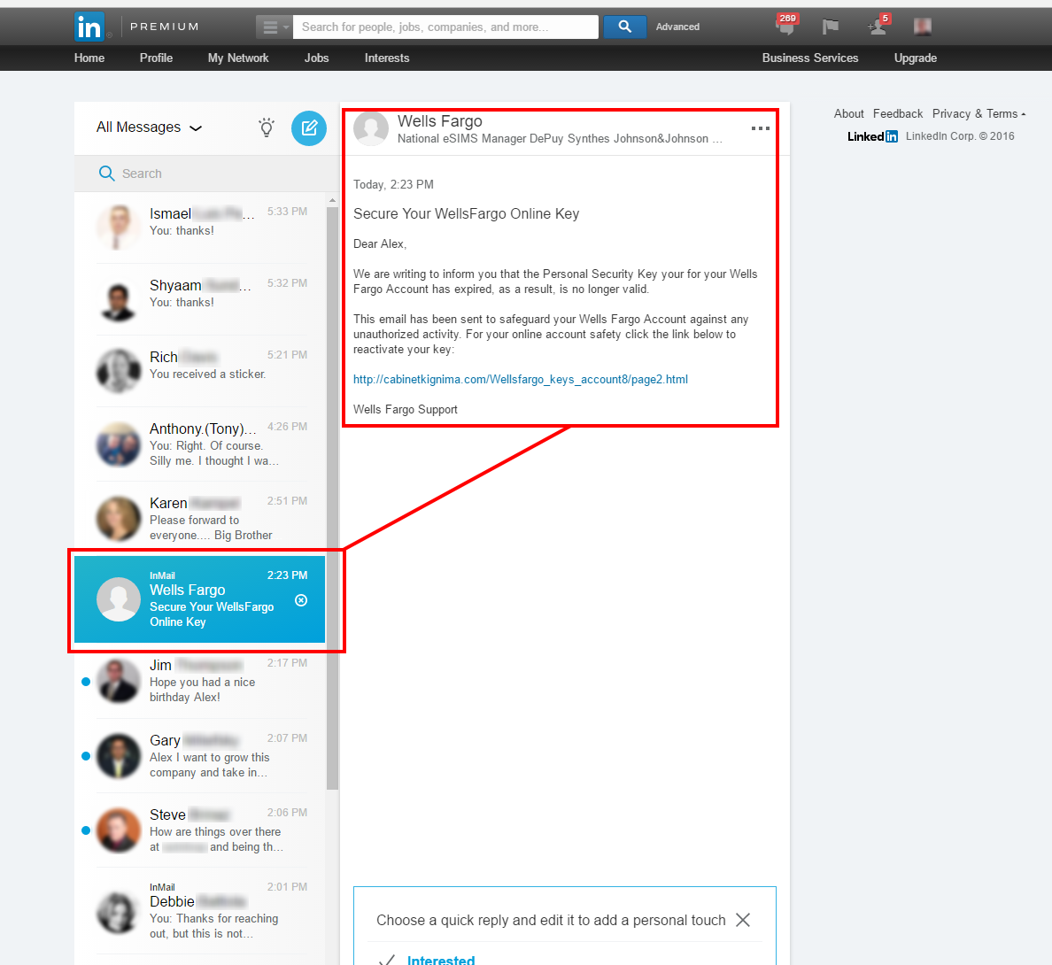
SOCIAL MEDIA

Slide 18
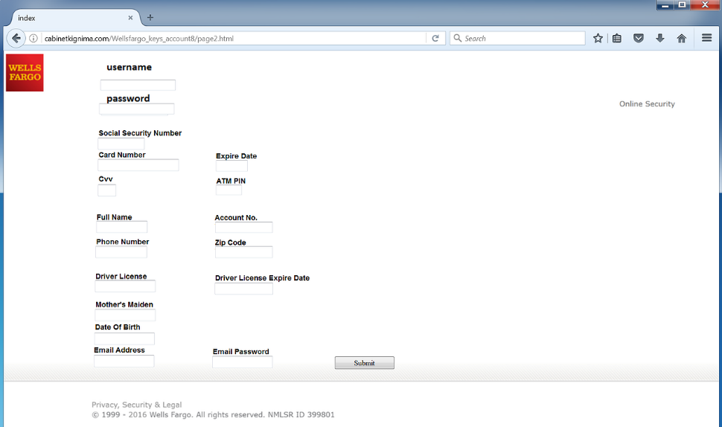
SOCIAL MEDIA – Part II

Slide 19
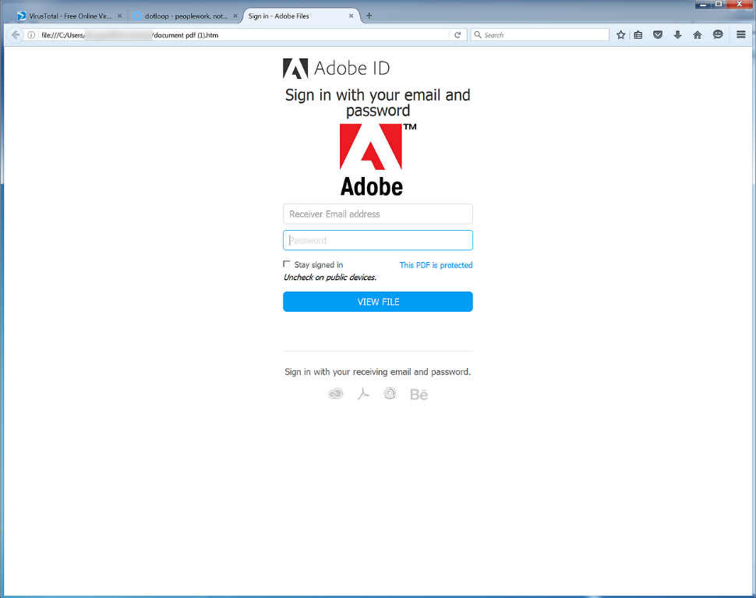
Infected Attachments

Slide 20
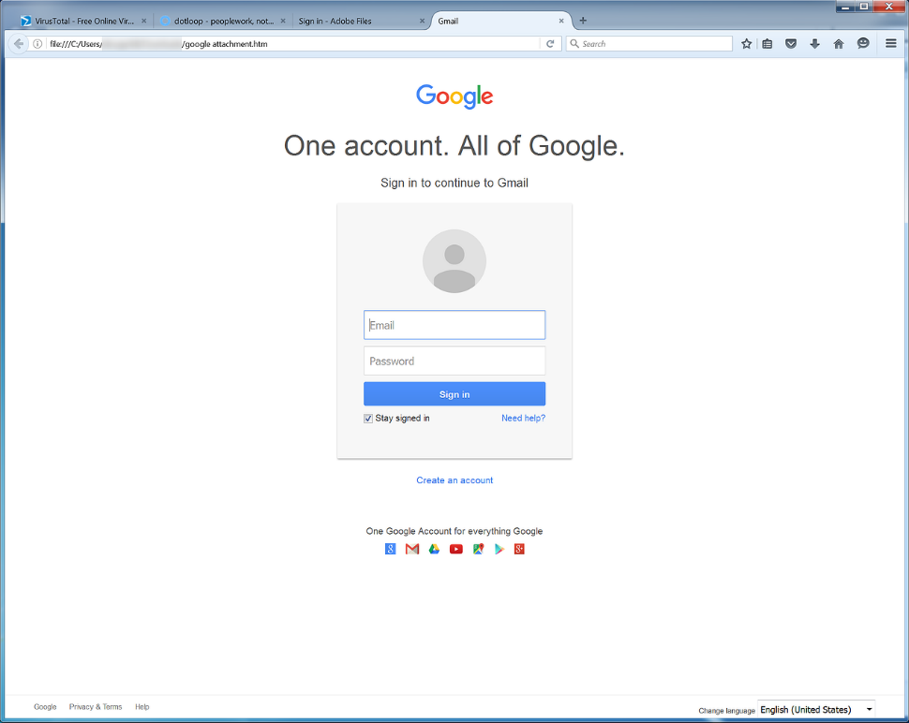
Infected Attachments

Slide 21
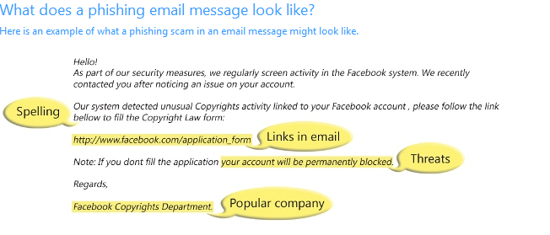

Slide 22
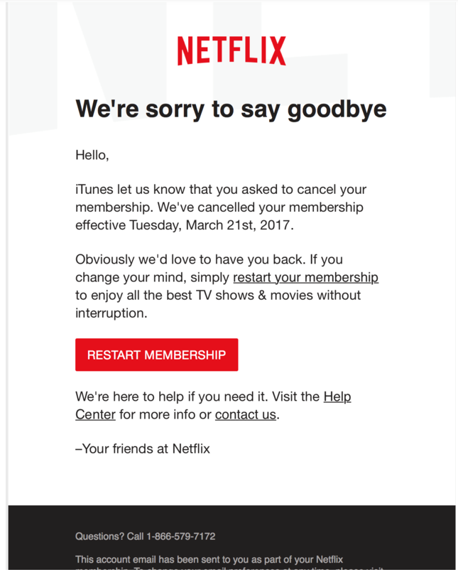
Links in Email

Slide 23
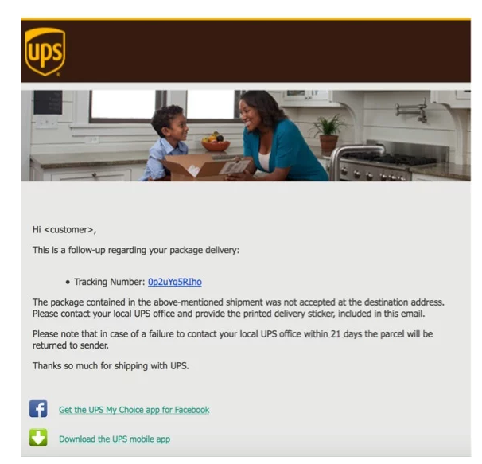
Miss Delivery

Slide 24
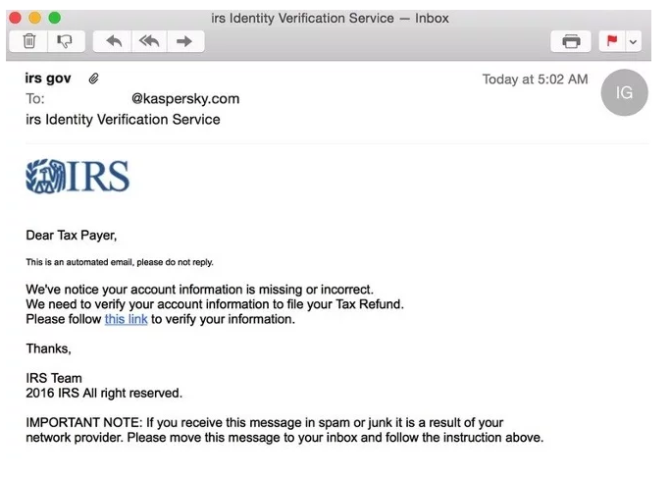
IRS SCAM

Slide 25
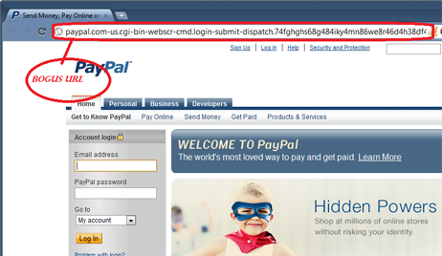
Bogus URL

Slide 26
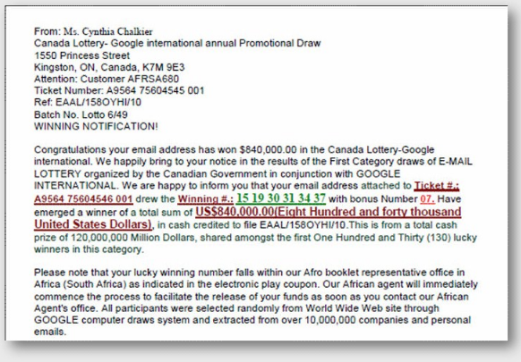

Slide 27
Ransom Ware
Malicious Software which aims to disrupt you in some way and offers you the chance to remove that disruption for a fee.
Currently Encryption is the favoured tool.
Email is the number 1 infection path
Infected systems can encrypt shared files across the whole business.
The Motive is Profit.

Slide 28

Business Case – Research from Jamison Utter
Ransomware With 90 Days Support cost $3,000
Guaranteed 10% infection rate
Expect 0.5% pay out
SEO and Traffic Acquisition campaign $3,000
Guaranteed traffic rates 20,000 clicks a day.
Ransom one Bitcoin approx. $300 at the time.
Notes:
This is research from Jamison Utter while he was at InfoBlox, and Jamison wanted to find out about the process of setting up a ransomware campaign. Jamison is a super smart guy but wanted to do this using no specialist or coding skills.
He went to the Dark Web and found someone who would supply him with all he needed run a ransomware campaign, code, payload etc. the supplier even gave guaranteed infection rates and 90 days of support for $3,000 Dollars.
Click
They quoted a guaranteed 10% Infection Rate
Click
They quoted a half a percent pay out.
Click
Next Jamison needed to drive traffic to his new campaign, just like most of us in business need to do and so he engaged someone, again on the Dark Web to do Search Engine Optimisation and Traffic Acquisition for him. Again this came with Guarantees.
Click
This time “of clicks per day”.
Click
Jamison was in principle going to ask for 1 Bitcoin which at the time was around $300 Dollars.
Now I just want to point out Jamison never ran the campaign but here we have all the components for him to do so if his motives were different.
So Let’s look at the Maths.
Click

Slide 29
The Maths
20,000 visitors x 10% Infection Rate
= 2,000 Infections
2,000 x 0.5% pay-outs = 10 pay-outs
10 pay-outs x $300 x 90 days
= $270,000
Notes:
The Maths
Click
20,000 visitors with a guaranteed Infection Rate of 10%
Is 2,000 Infections per Day
Click
With a half a percent pay out makes 10 pay outs per Day
Click
10 pay-outs of $300 for 90 days is
Click
= $270,000
Now that’s a pretty compelling ROI.
And this isn’t a Dragons Den pitch trying to get you all to invest.
We can see why it’s become the cyber criminal’s favourite technique for making money.
With this in mind let’s look at some of the campaigns we’re seeing in the wild.
Click

Slide 30


Should we Pay?
Paying a ransom does not guarantee an organization will regain access to their data; in fact, some individuals or organizations were never provided with decryption keys after having paid a ransom.
Some victims who paid the demand have reported being targeted again by cyber actors.
After paying the originally demanded ransom, some victims have been asked to pay more to get the promised decryption key.
Paying could inadvertently encourage this criminal business model.
Notes:
Well if you’re in a situation where you have to, then you have to. But as we’ve seen the ROI is huge so anything we do to reduce the percentage that pay out as well as reduce the percentage getting infected then we can damage the ROI and make it less attractive for the cyber criminals.
I read on the register that destroying the Business Model is not your job, and of course it isn’t but if you do pay then you’re an ideal customer, would the cybercriminal target you again, perhaps 1 bitcoin was easy for you to pay, so next time they’ll ask for 3.
I’m not trying to scare you but the research shows they are very keen to give good customer service and knowing the customer is important.
Click

Slide 31
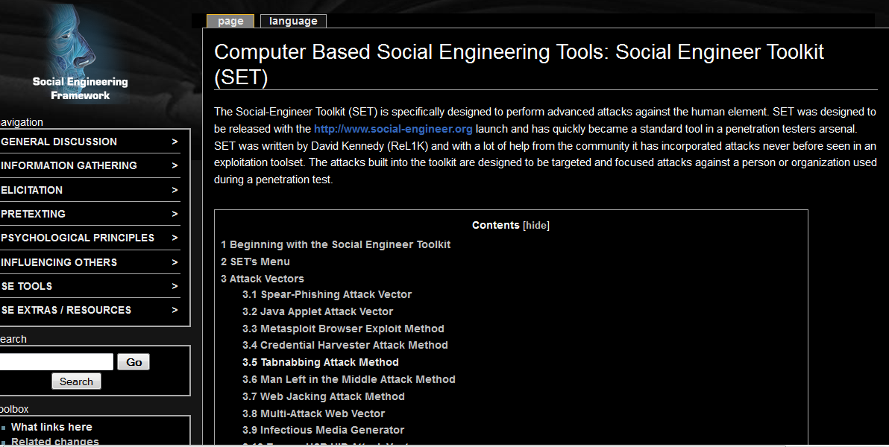
Social Engineering Tool kits

Slide 32
How ??
The Goal of Social Engineers establish is to establish trust and obtain information!!

Slide 33
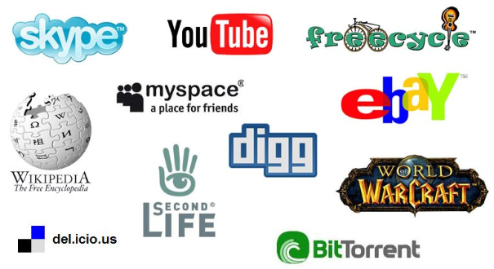


Social Networking

Slide 34
What Else do they want
Any and every bit of information is valuable
• Ultimate goal - access to systems, usually by getting people to trust them
• How much information do you already give out about yourself?

Slide 35
Social Media Sites
Facebook/Linkedln are goldmines!
Without meeting you, the social engineer can often know:
Nicknames, family member names, your friends, your pets, your hobbies, your religion, your sports teams, your vacation schedule, your job title, your company, your birthday, your age, your location, your coworkers, your face ...
- Because you published them!

Slide 36
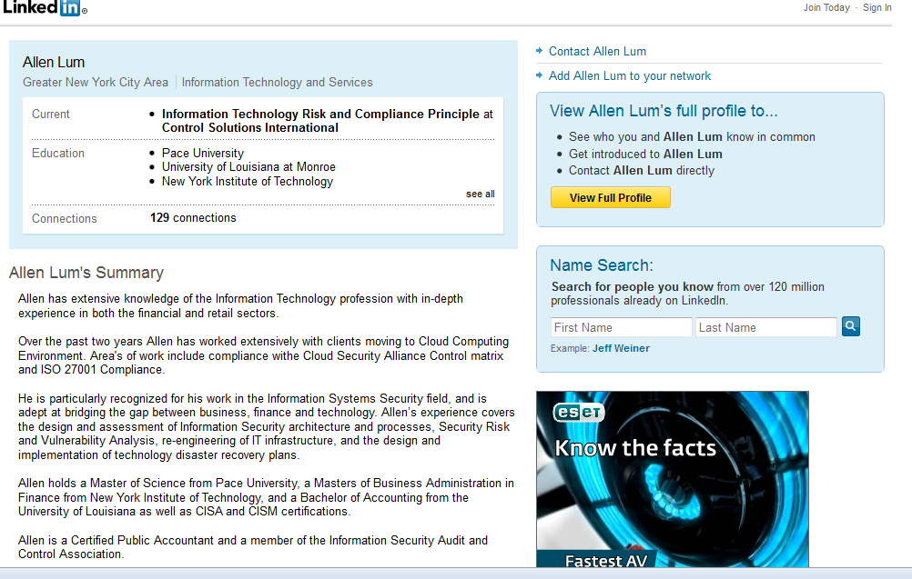
LINKED in

Slide 37
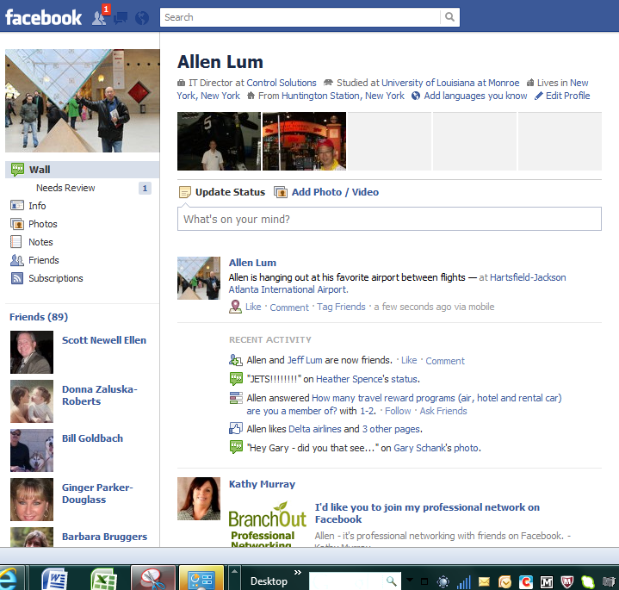

Slide 38
Blended attacks
Most companies still have good perimeter IT
defenses but poor internal controls
• Social engineers use a combination of human and computer hacking to take advantage
• Once they get internal access to your network they are often 90°/o there

Slide 39
The Bad News
It is nearly impossible to defend against a motivated social engineer with unlimited time
- He could become an employee or a contractor (or a janitor)
- What if he/she became your DBA or sysadmin?
- Think international espionage

Slide 40
Specific Defenses
Create specific procedures and policies for all conceivable situations
- Example: Verifying a caller in a support center
Escalate grey areas, resolve them, and add them to the policy
Teach people to blame the policy!
Test the policies/procedures/processes

Slide 41
Defenses - People
Awareness! Teach with specific examples.
A pretty woman can get a guy to do anything
• Balance helpfulness with wariness
• Consequences of making a mistake
• The same tools can help them in their own personal lives

Slide 42
Social Engineering Summary
Social Engineering main objective is get the target to perform an action
Social Engineering is used as part of an overall attack strategy
Emails are most common avenues of attack.

